Slide 1
Environmental Principles and Habitat Priorities for Sustainable Lake Michigan Fisheries
Dave Clapp, Charlevoix FRS
Matt Herbert, TNC
Lake Michigan Committee
Ypsilanti, MI
March 26, 2019

Slide 2
Objective / Charge
(From LMC, Spring 2017)
…develop a short list of priority actions to protect or improve functional habitats for sustainable fisheries, with a focus on Lake Michigan…

Slide 3
The Premise:
Sustainable fisheries can occur across the basin if…
functional habitats are protected or improved in each lake
through a systematic, adaptive, cumulative, and collaborative approach that
accommodates fishery value in decisions to
act on manageable anthropogenic stresses.
Notes:
The premise is that FCOs can be met across the basin if functional habitats are identified, protected or improved in each lake through a systematic, adaptive, cumulative and collaborative approach that accommodates fishery value in decisions to act on manageable anthropogenic stressors.
Principles will be applied by ‘applicators,’ which are agencies or entities with desire and authority to protect, restore or enhance habitats.
Principle 1: Sustainable fish production to achieve FCOs requires a diversity of functional habitats.
FCOs include multiple species, stocks, vary among lakes
Different life histories and life stages but similar life support requirements
Also calls for potential applicators to be made aware of designated functional habitats
GUIDING PRINCIPLES
The EOs for Lake Huron are intended to provide practical and effective suggestions to overcome existing environmental impediments that are acting as barriers to achieving FCOs. In order for these EOs to be relevant and accessible they should be consistent, to the extent possible, with the following properties:
• Address current and emerging ecosystem issues (water level fluctuations, nutrient inputs, climate change, stocking and prey base dynamics, changes in food web structure, etc.) • Identify critical habitats and their attributes (ex. wetland size, integrity, diversity) • Where possible be quantifiable (provide desirable end-points) • Address habitat impairment issues identified in the FCOs • Promote and maintain biodiversity (genes, populations, communities and landscapes)

Slide 4
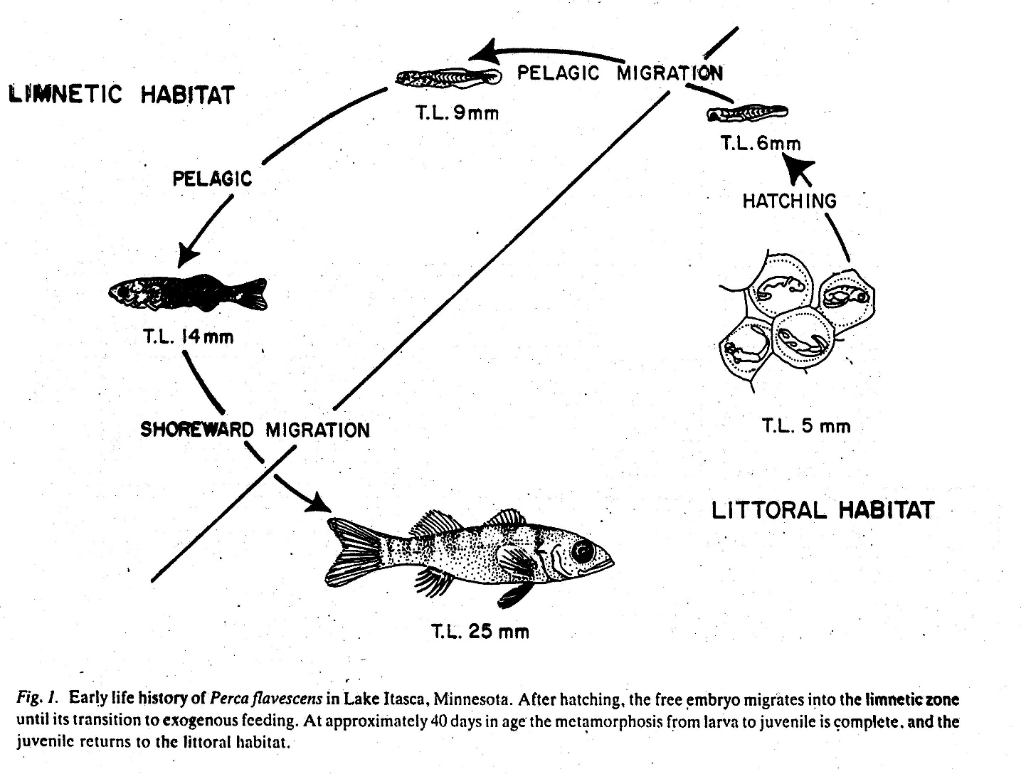
Yellow perch life cycle
(from Whiteside et al. 1985)

Slide 5

Not restricted to Lake Michigan
Environmental Principles for Sustainable Fisheries in the Great Lakes
Common Session, Lower Lakes Committee Meeting
Jeff Tyson
Notes:
Recently , the CLC approved environmental principles for sustainable fisheries in the Great Lakes.
It was developed by a subcommittee of CLC and GLFC reps with an intended purpose of providing consistent guidance from fisheries managers to a suite of regulatory and non-regulatory “applicators” that can protect and improve aquatic habitat in the Great Lakes. The CLC’s perception is that many applicators may not know what, where, or how to protect/improve the aquatic environment in a manner that supports fish production.
Application will be lake-specific to support achievement of EOs and FCOs, so I will end my ppt with thoughts about application in Lake Huron.
In the end, these principles will either be used or constitute another document that sits on a shelf and collects dust. Their implementation will largely fall on your shoulders. So I am here to talk to you about the EPs, how they can be generally applied, how you might apply them in Lake Huron.

Slide 6
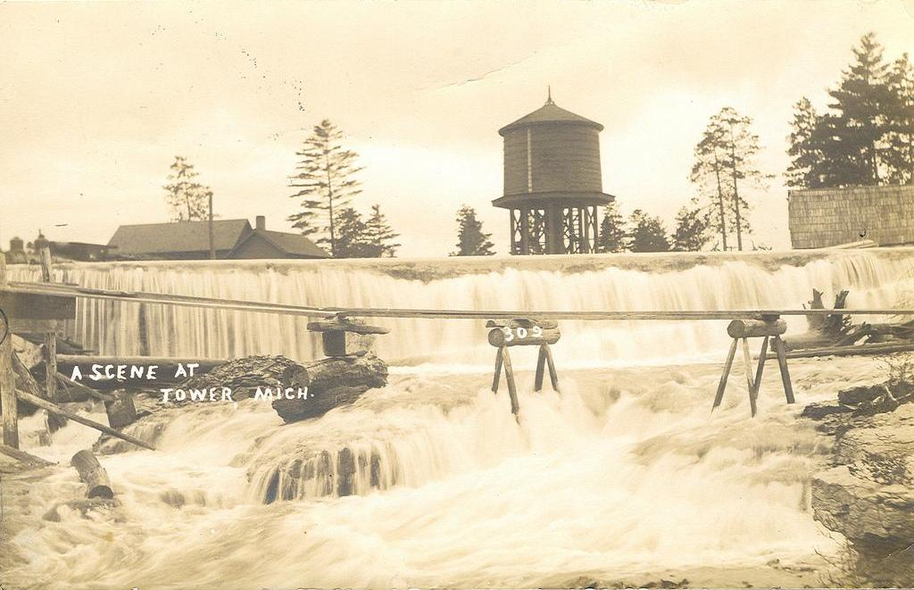
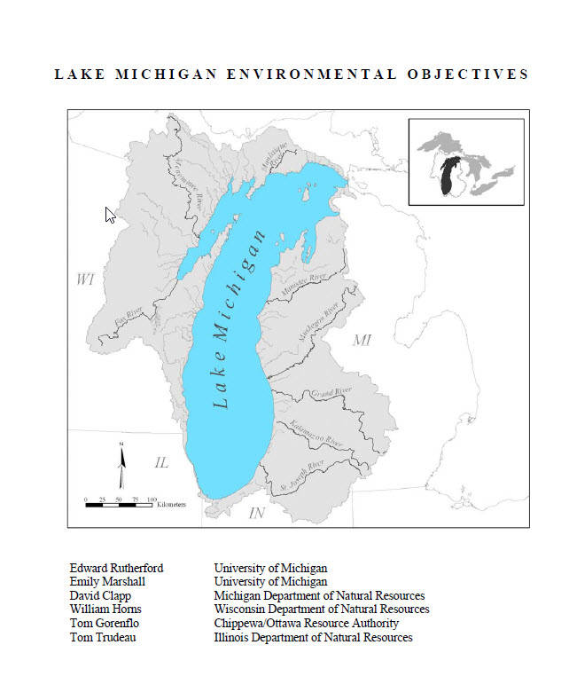
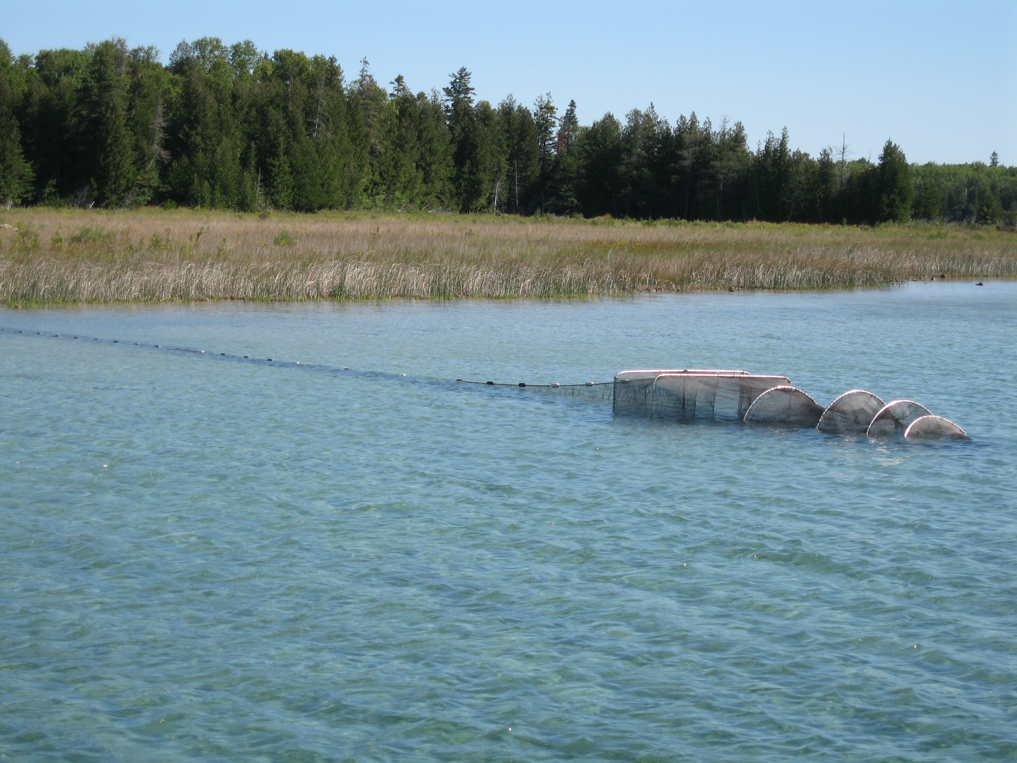
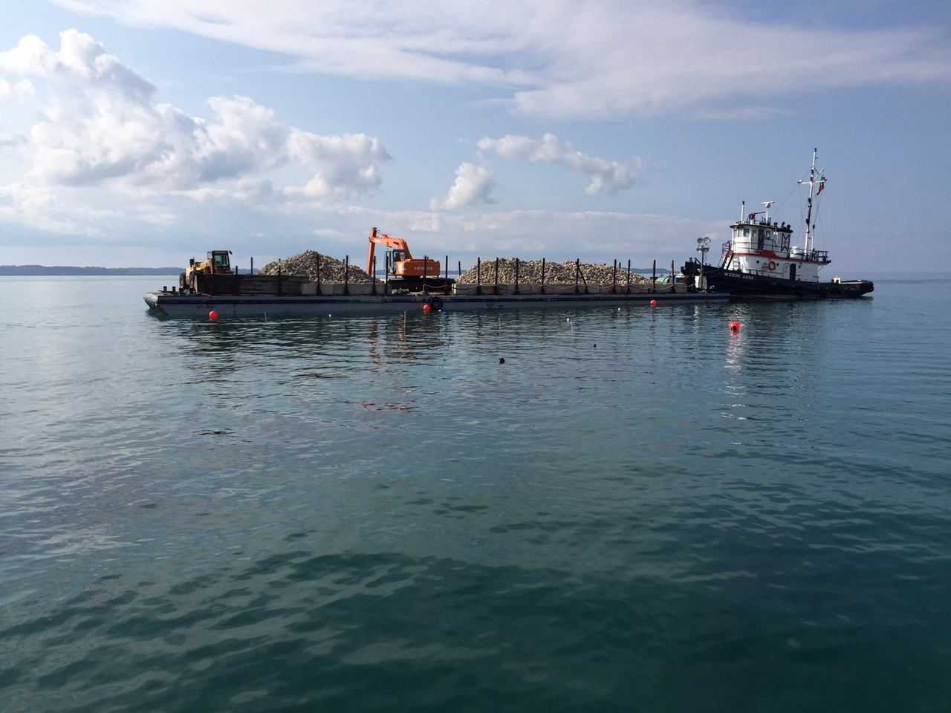
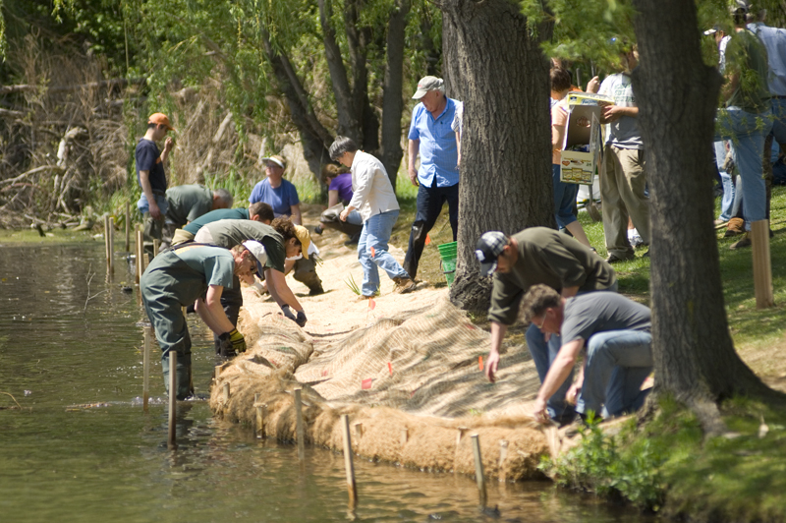
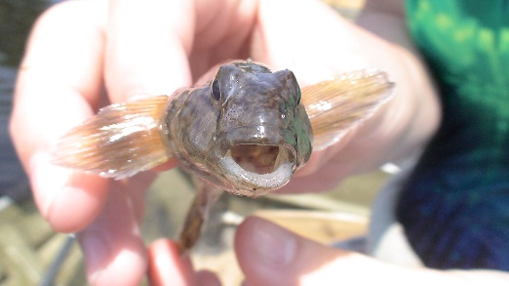
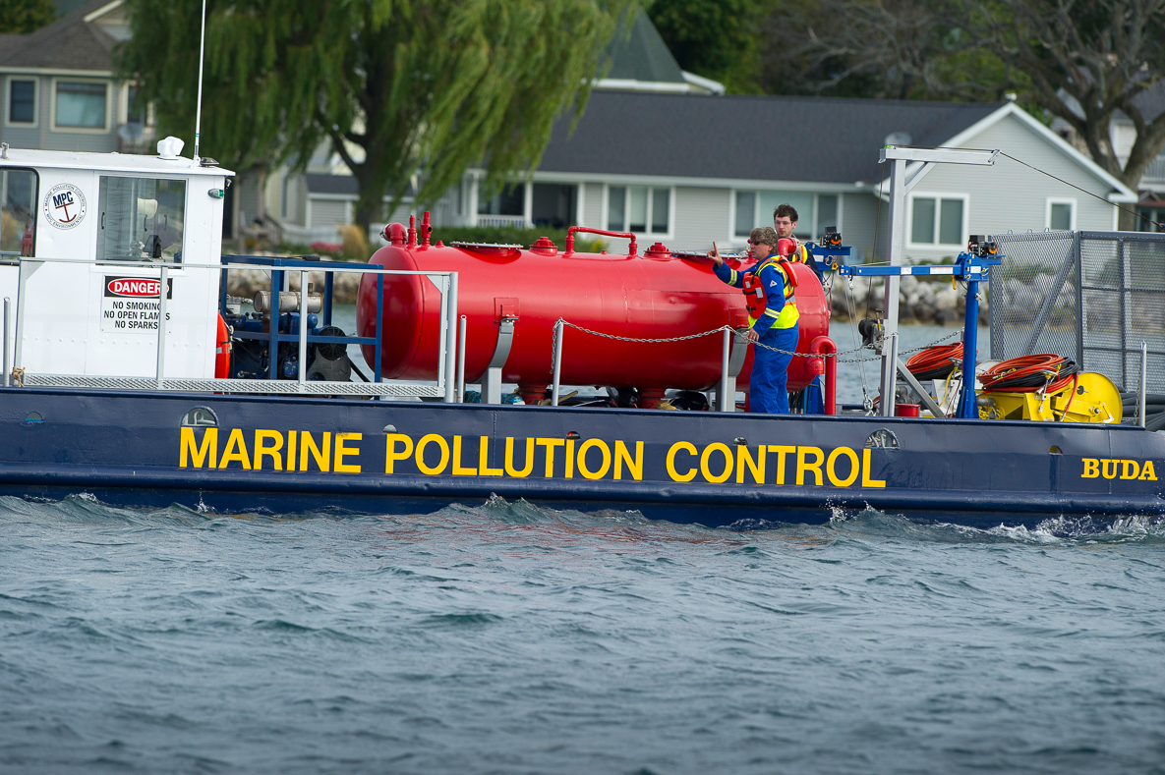
Not the first time we’ve tried

Slide 7
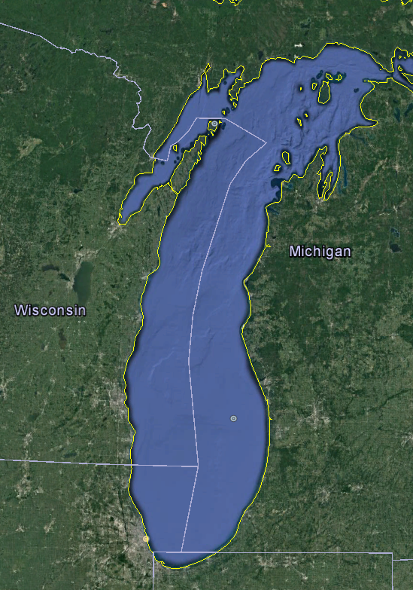
Hypothetical Functional Habitats in Lake Michigan
Large and small tributaries
Reefs and reef complexes
Open lake environment
Bays and drowned river-mouth lakes

Slide 8
Example…Grand Traverse Bay Cisco
Species / life stage: Cisco / eggs & early age-0
Functional habitat: Grand Traverse Bay
PMA: High quality spawning & nursery habitat
Status: Reduced availability, threatened by AIS
Certainty: High
Impediment: Early survival is reduced relative to historic
Action: Increase and improve habitat through protection or restoration
Certainty: Moderate
Time frame: 0 to 10 years

Slide 9
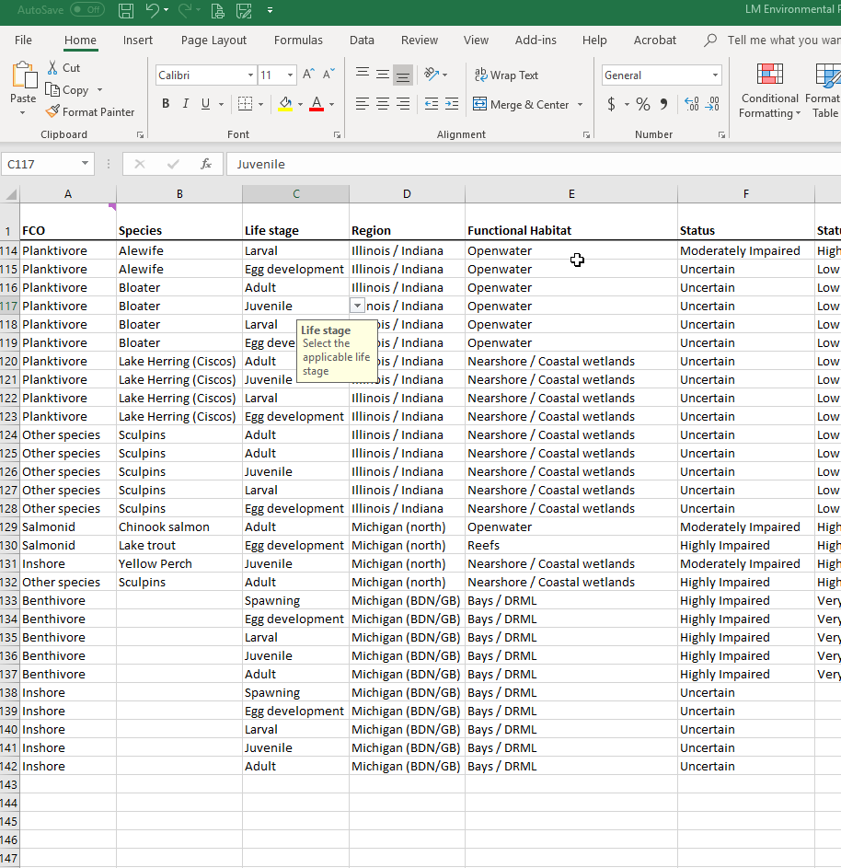
Lake Michigan EP Tool (2019)
FCO
Species
Life stage
Region
Functional Habitat
Status
Status certainty
Impediment category
Impediment
Impediment source
Impediment notes
Impediment certainty
PMA / Specific locations
Management Action
Management Action notes
Management certainty
Time to response
Other species benefits
References

Slide 10
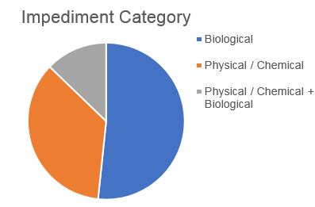
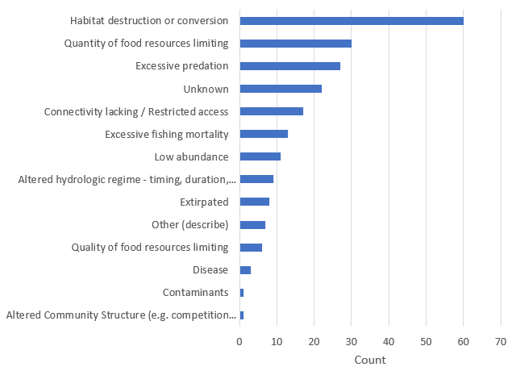
Example summary: Impediment Category

Slide 11
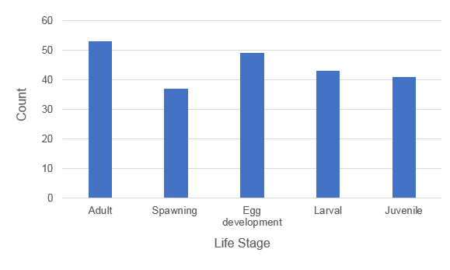
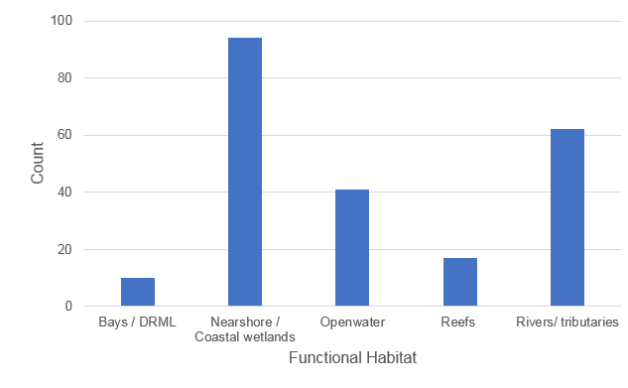
Example summary: Life Stage and Functional Habitat

Slide 12
Prioritization Process Questions
FCO
Species
Life stage
Region
Functional Habitat
Status
Status certainty
Impediment category
Impediment
Impediment source
Impediment notes
Impediment certainty
PMA / Specific locations
Management Action
Management Action notes
Management certainty
Time to response
Other species benefits
References
Also possible
Is it actionable?
Species type (restoration, native or introduced)
Are there funding Sources?
Quantifiable habitat benefits (i.e., acreage or km)

Slide 13
Prioritization Process Questions
FCO
Species
Life stage
Region
Functional Habitat
Status
Status certainty
Impediment category
Impediment
Impediment source
Impediment notes
Impediment certainty
PMA / Specific locations
Management Action
Management Action notes
Management certainty
Time to response
Other species benefits
References
Also possible
Is it actionable?
Species type (restoration, native or introduced)
Are there funding Sources?
Quantifiable habitat benefits (i.e., acreage or km)

Slide 14
LMC Priorities – Functional Habitat
Status assessment
  Highly Impaired
  Moderately Impaired
  Impaired
  Slightly Impaired
Assign Rank based upon what’s most important to LMC
(e.g. Highly impaired – 4; Slightly impaired – 1)
Status Certainty
  High
  Moderate
  Low
Assign rank based upon certainty of status assessment
(e.g. High – 4, Low – 1)

Slide 15
LMC Priorities – Impediment and Action Certainty
Impediment Certainty
  High
  Moderate
  Low
Assign rank based upon certainty of impediment identification
(e.g. High – 4, Low – 1)
Action Certainty
  High
  Moderate
  Low
Assign rank based upon certainty that action will address impediment
(e.g. High – 4, Low – 1)

Slide 16
Next steps…
Add additional records / impediments
QAQC (all jurisdictions)
Refine prioritization process
Develop GIS tools
Presentations and reports for practitioners

Slide 17
Task Group
Michigan: Paul Seelbach, Nathan Barton, Matt Herbert, Kevin Donner, Dave Clapp
Wisconsin: Rob Elliott, Joe Sheahan, Cheryl Masterson
Illinois: Steve Robillard
Indiana: Nate Thomas
Multi-state resource persons: Ed Rutherford, Pete McIntyre
Advisors: LMC, Jeff Tyson, Roger Knight, John Dettmers

Slide 18
Thank you!

